Slide 1
Chem vs. ChemE
Showdown
Presented by Saaket Agrawal and Alp Sunol
Jointly sponsored by
Caltech Chemistry Club and Caltech AIChE Chapter
1 April 2015

Slide 2
Philosophy and General Outlook
Chemistry
Understanding fundamental chemical concepts (chemical bond/reactivity, etc.) at their core and exploiting them for practical applications.
Subfields:
Inorganic chemistry – catalysis, alternative energy, polymer design
Organic chemistry – drug design, catalysis
Biochemistry – protein structure, biocatalysis
Physical chemistry – spectroscopy, electronic structure
Analytical chemistry – identification, quality control
Chemical Engineering
Understanding and finding engineering applications for molecular processes
Broad field, overlapping with many other disciplines
Traditional fields:
Chemical plants
Process engineering
Modern fields:
Biological systems
Environmental systems
Materials and fluids
Everything
What you will be learning and doing are very different!

Slide 3
Lecture Coursework
Chemistry
Emphasizes basic requirements in organic (Ch41abc) and physical chemistry (Ch21abc)
#1 chemistry department in the world
Lots of flexibility: enables students to pursue their own intellectual interests
Minimal coursework requirements allows for research time allotment.
Emphasize those areas you enjoy and/or plan to pursue, avoid those you do not
Chemical Engineering
Quantitative coursework:
“ChE Core:”
Thermodynamics
Transport (fluids, heat, mass)
Kinetics
Applied mathematics
Basic chemistry
Tracks: additional coursework in a focused discipline:
Biomolecular Engineering
Environmental Engineering
Materials Science
Process Systems

Slide 4
Laboratory Coursework
Chemistry
Five terms of advanced laboratory classes required. Choose from*:
*You can also petition for one additional non-chemistry lab to satisfy this requirement!
Chemical Engineering
ChE 9: Basic chemical synthesis skills
ChE 126a:
General training for being an effective researcher
Open-ended projects with partially self-defined goals
Presentation skills
Writing skills
Track-specific design lab (ChE 118, ChE 120, ChE 128, or ChE 130) or two-term senior thesis
Ch4ab | Basic synthesis and analysis techniques
Ch5a | Organic synthesis
Ch5b | Inorganic and organometallic chemistry
Ch6ab | Physical chemistry
Ch7 | Bioorganic chemistry
Ch15 | Analytical chemistry
Bi10 | Cell biology
Ch10c | Freshman research

Slide 5
Requirements
Chemistry
Chemical Engineering
Ch14 | Chemical Equilibrium
Ch90 | Oral Presentation
5 advanced electives (any Ch listed classes 100 or above)
5 terms of advanced lab courses
Both Options
ChE62 | Separations Processes
ChE15 | ChE Computation
ChE63ab | Thermodynamics
ChE103abc | Transport Phenomena
ACM95ab | Applied Mathematics
ChE101 | Kinetics
ChE105 | Control and Dynamics
Ch/ChE 9 | Chemistry lab
ChE 126 | Senior lab
Track : 1 advanced lab or senior thesis + 7 directed electives
Core Curriculum
Ma2 | Differential Equations
Ph2a/12a | Waves
Ch41abc | Organic Chemistry
Ch21abc (Ch 24, 25) | Physical Chemistry or Biophysical Chemistry
Ch/ChE 91 | Scientific Writing
14 Terms of lecture courses
5 Terms of laboratory courses
26 Terms of lecture courses
3 Terms of laboratory courses

Slide 6
Research for Credit
Chemistry
Ch 80 Chemical Research
Up to 27 units for credit
Ch 82 Senior Thesis
27 more units of research for credit
Satisfies Scientific writing (Ch91) requirement
Ch10c
8 units of research for credit
Offered third term and typically taken by freshmen right before their SURFs
Chemical Engineering
•ChE 80 Undergraduate Research
Can be taken as an elective, but only before senior year
Must be in ChE department
May be able to count for track elective in some tracks
•ChE 90 Senior Thesis
18 units over 2 terms: 9 units satisfy science/engineering electives, other 9 units satisfy track specific lab requirement
Can be outside ChE department

Slide 7
Life After Tech
Chemistry
Trained to solve theoretical problems, as well as real life applications
Teaching experience due to TA-ing opportunities
Graduate work is strongly desirable for most attractive jobs
Academia
Research and development : Pharmaceutical industry
Biotechnology
Chemical industries
Medical school
Consulting
Chemical Engineering
Trained to be both an engineer and a scientist
Broadly applicable, highly marketable skills
Lots of Matlab
Diverse job opportunities
Major industrial employment:
Biotechnology
Pharmaceuticals
Fuel & Alternative Energy
Chemical industries
Electronics and semiconductors
Environmental engineering
Other options:
Finance
Consulting

Slide 8
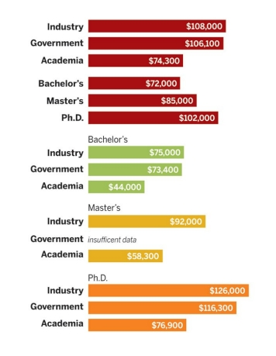
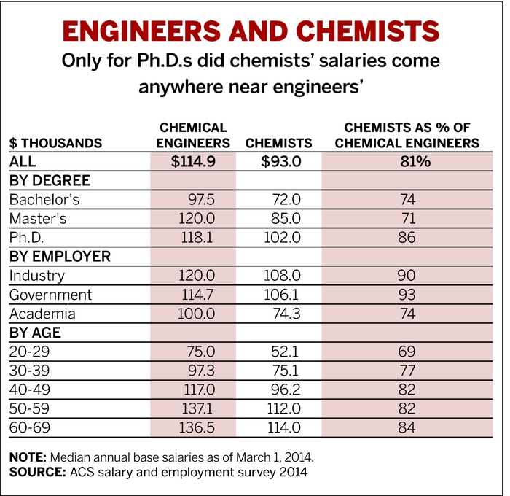
Median Salaries
Chemistry
Chemical Engineering

Slide 9
Thank you!
Any questions?
Presented by Saaket Agrawal and Alp Sunol
Jointly sponsored by
Caltech Chemistry Club and Caltech AIChE Chapter
1 April 2015

